Slide 1
Kubernetes
Notes:
1

Slide 2

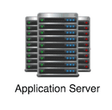
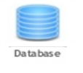

Problem statement
Webserver
Application Server
Database
Caching
Libraries
Dependencies
Compatibility & Dependency
Long setup time
OS
Dev/Test/Prod environment
Hardware Infrastructure
Notes:
2

Slide 3


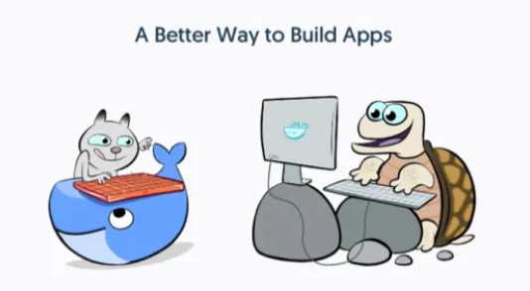


What is Docker ?
Notes:
Kubernetes is an orchestration tool which allow us to run manage container based workloads.
3

Slide 4
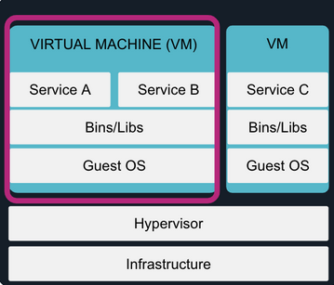
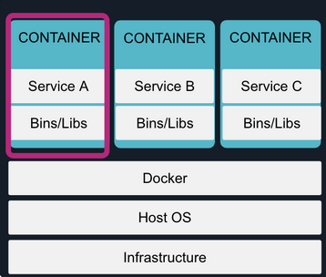
Docker

Slide 5
Containers
Webserver
Application Server
Database
Caching
Libs
Deps
Libs
Deps
Libs
Deps
Libs
Deps
Docker
OS
Hardware Infrastructure
Notes:
5

Slide 6
Containers
OS Level Virtualization
Better resource utilization
Notes:
6

Slide 7
What is docker in a nutshell?
Namespaces
CGroups
Overlay Filesystem

Slide 8
Namespaces
MNT file system
NET network
UTS hostname
PID process
USER user
IPC inter process communication

Slide 9
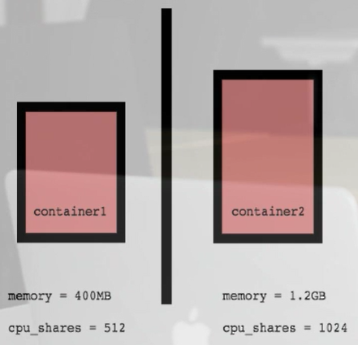
CGroups
Resource metering and limiting
Memory
CPU
Block IO
Network

Slide 10

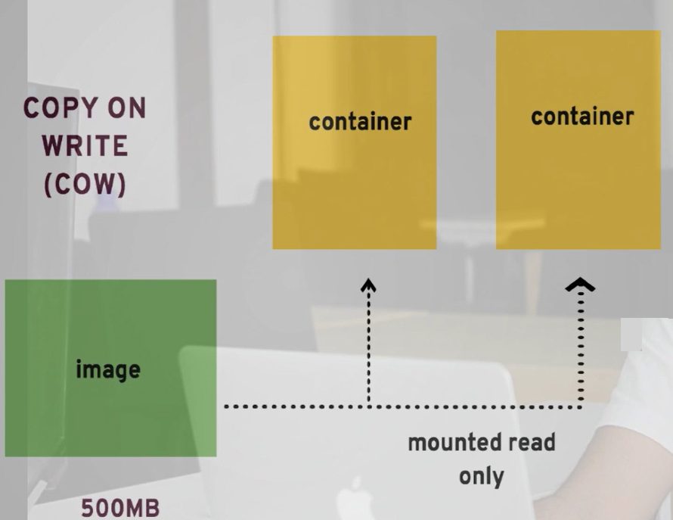


Filesystem

Slide 11
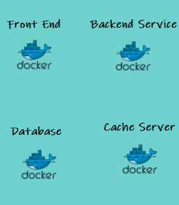
Container Orchestration

Slide 12
Challenges in Container Infrastructure
Which container should run on which server ?
How do we deploy containers based on resource utilization of servers ?
How to monitor and manage all those server and schedule automate this process ?

Slide 13
What do we need ?
Automating deployment
Scaling
Managing your containerized applications

Slide 14
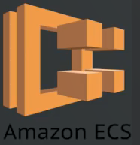

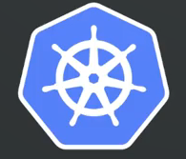
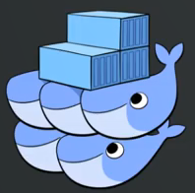
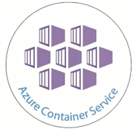
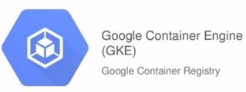
Container Orchestration

Slide 15
Why Kubernetes?
Born from a Google internal project (Google BORG)
Based on an extensive experience from Google,
over a long period of time
Large opensource community and support

Slide 16
What does Kubernetes offer?
Powerful tool for Docker container orchestration without having to interact with the underlying infrastructure
Standard deployment interface
Build on a Modular API

Slide 17
CKA admin
Design and Install
Networking
Security
Scheduling
Logging / Monitoring
Maintenance Upgrade
Application Life cycle Management
Troubleshooting
Notes:
Kubernetes is an orchestration tool which allow us to run manage container based workloads.
17

